Slide 2
Unit 3: Control Structures (6hrs)
Introduction and types of control statements- sequential, branching, and looping statements
Branching statements- simple if statement, if-else, nested if. if-else-if ladder and switch statements
Looping statements- for loop, while loop, do-while loop, nested loop
The break, continue, and goto statements

Slide 3
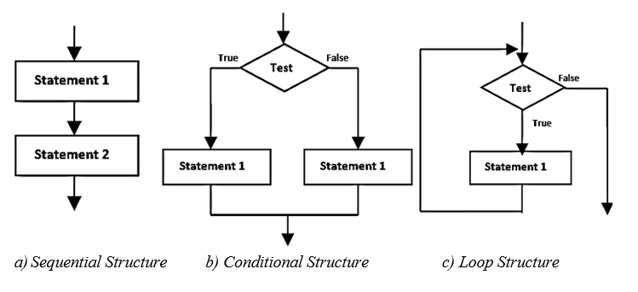
Control Structures
Control structure refers to the structure of program that may be sequential or conditional or iterative.

Slide 4
Control Statements
The statement that alters the flow of execution of the program is known as control statement.
These control statements divert the control flow from one point to another point in a program.
There are three types of control statements in C-programming.
Branching Statement
Loop statements
Jumping statements

Slide 5
Looping statements
Loop statements are the control statements that allow us to execute a block of statements repeatedly until a certain termination condition is met.
Three looping statements:
while loop
do-while loop
for loop

Slide 6
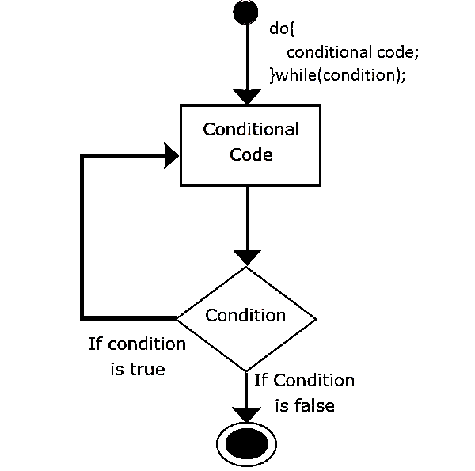
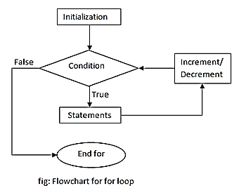
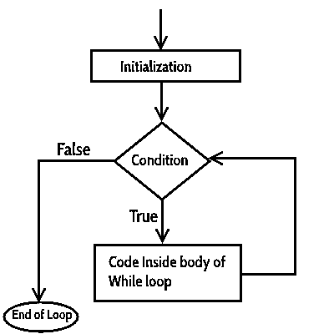
while loop
do-while loop
for loop
while (condition)
{
statements;
}
do
{
statement;
}while(condtion);
for(initialization; condition; increment/decrement)
{
statements;
}

Slide 7
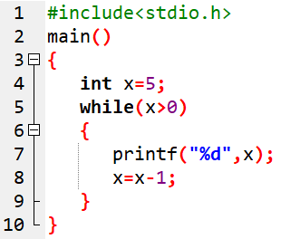
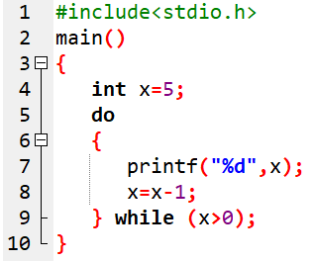
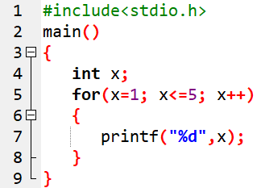
while loop
do-while loop
for loop

Slide 8
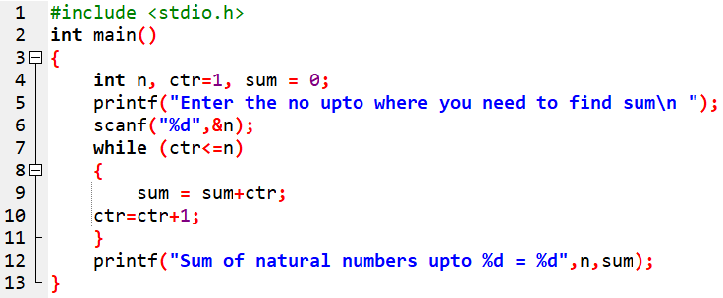

Prog 13. WAP to find the sum of N natural numbers using while loop.

Slide 9
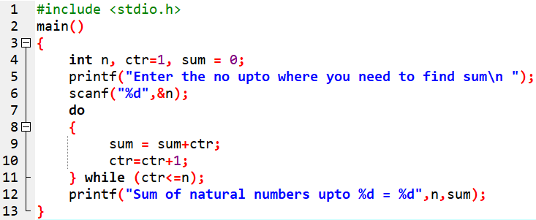

Prog 14. WAP to find the sum of N natural numbers using do-while loop.

Slide 10
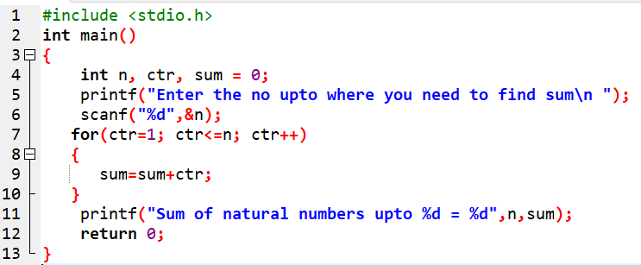

Prog 15. WAP to find the sum of N natural numbers using for loop.

Slide 11
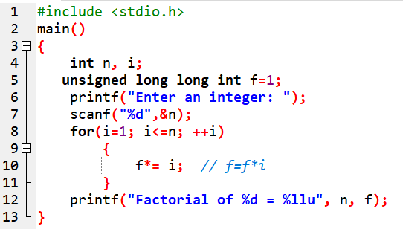

Prog 16. WAP to find the factorial of a given number.

Slide 12
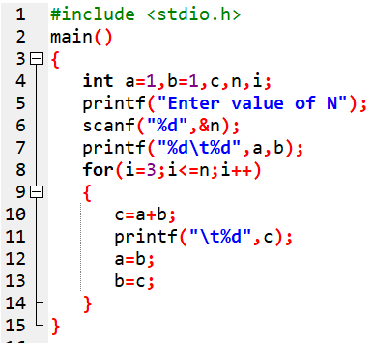

Prog 17. WAP to generate a Fibonacci series 1, 1, 2, 3, 5, 8, 13,…….n.

Slide 13
Loop control statement
These statements can control the continuous execution of the loop.
These are :
break,
continue
goto.

Slide 14
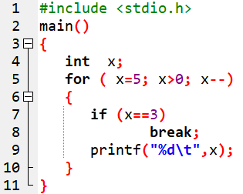
i) Break statement
When a break is encountered in a program,
remaining of the execution is terminated and
control is passed to out of the loop

Slide 15
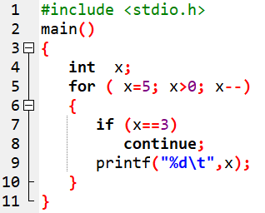

ii) Continue statement
Analyze this output:
Analysis: continue used to block certain loop and then continue onwards.

Slide 16
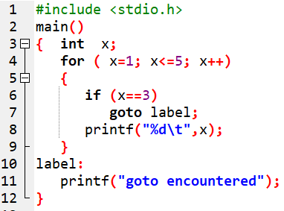
iii) Goto statement
When a goto statement is encountered in a loop,
the looping is terminated and
the control goes to the label specified by the goto statement.

Slide 17
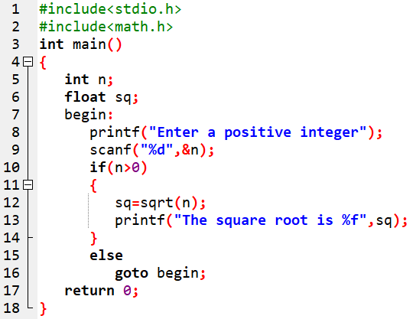

Prog 18. WAP using goto statement to find the square root of positive integer.

Slide 18
Assignment:
Differentiate between Entry-controlled loop and Exit-controlled loop in a tabular form.

Slide 19
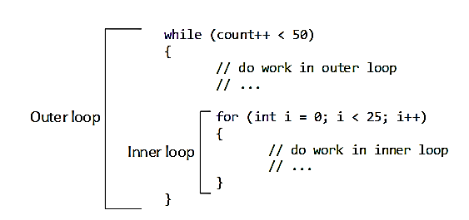
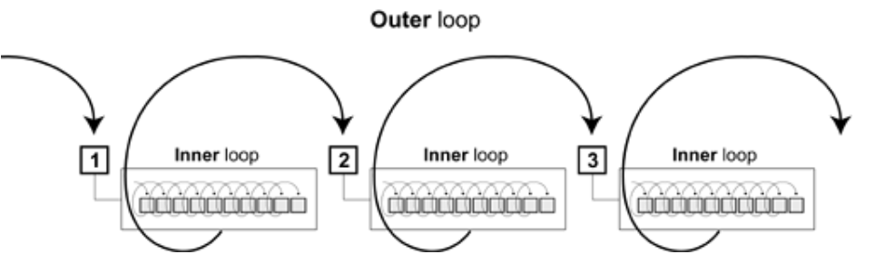
Nested Loop
Loop inside another loop
Outer loop called nesting loop
Inner loop called Nested loop

Slide 20
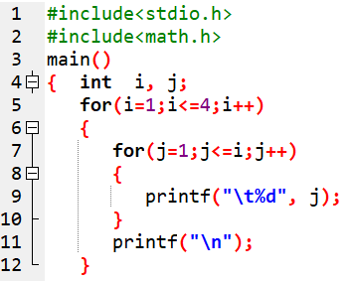
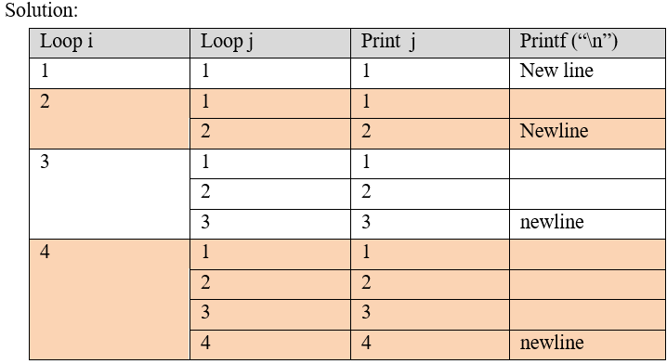
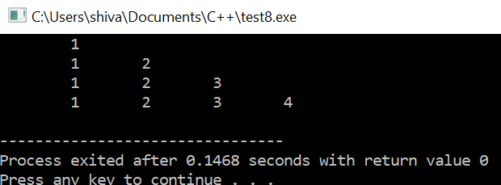
Trace the output of the below program:

Slide 21
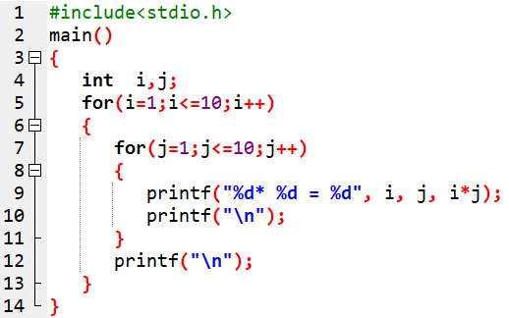
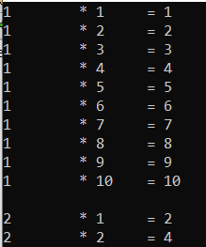
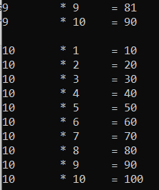
Prog 19. WAP to display the multiplication table of 1 to 10.

Slide 22

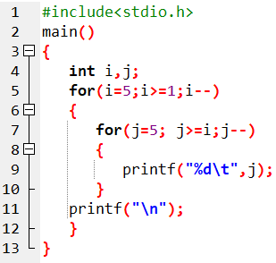
Prog 20. WAP to display the below pattern:

Slide 23
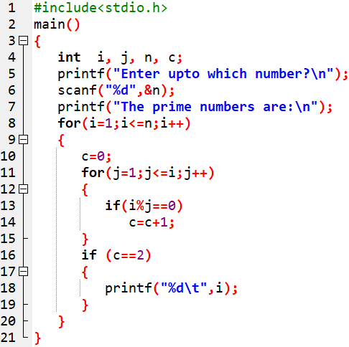

Prog 21. WAP to print all the prime numbers up to N number. Also draw the flowchart.

Slide 24
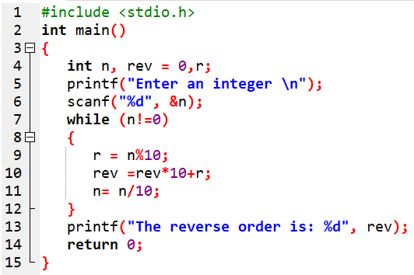

Prog 22. WAP to input an integer and print it in reverse order.

Slide 25
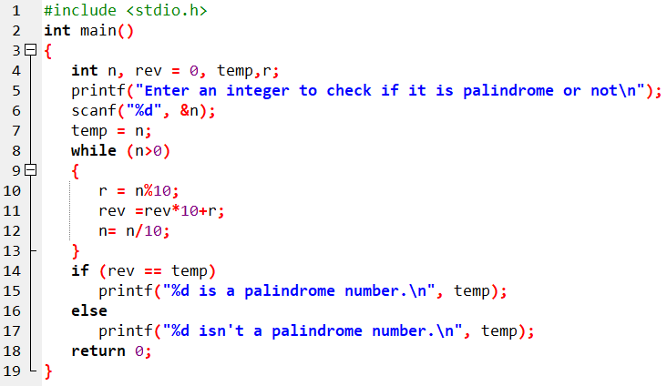

Prog 23. WAP to input an integer and check if it is palindrome or not.

Slide 26
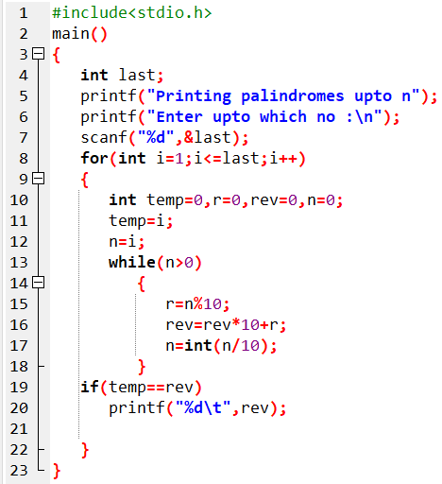

Prog 24. WAP to print all the palindrome numbers upto N.

Slide 27
End of Lecture 8

Slide 28
Arrays

